Slide 1
Big Mart dataset
Done by: Mohammed Mubeen Uddin
1604-20-747-039(DST-“5A”)

Slide 2
Overview:
“BIG MART” data set in collection of data from 10 stores in different cities .
“BIG MART”data had collected 2013 sales data for 1559 products.
With the help of python programming we can arrange this data in a proper manner.
Also we can case study and predict the sales growth and losses .
.

Slide 3
Introduction:
“BigMart” dataset is Handle by The Experience Data Scientist. Our AIM is to get insights from the dataset. In this project ,we try to understand the data how various features play a role in increasing the sales of “BigMart’.The given url is
Url:“https://raw.githubusercontent.com/AmenaNajeeb/Data/master/bigmart_data.csv”
The “BigMart” provides all the customer needs . And look forward to improve thier services.

Slide 4
Description of Dataset:
We have the following in Dataset:
The Number of Rows are 8523 .
The Number of Columns are 12 .
The shape is (8523,12) in Tabular form .
The Total number of products sold are nearly 51,000.

Slide 5
Variable | Description
Item_Identifier | Unique product ID
Item_Weight | Weight of the product.
Item_Fat_Content | Where the product contains fat or not
Item_Visibility | The percentage of product displayed in store .
Item_Type | The category of which the product belongs.
Item_MRP | The Maximum Retailed Price of product.
Outlet_Identifier | Unique ID of store
Outlet_Establishment_Year | The year in which the store was established.
Outlet_Size | The size of store in case of ground level
Oulet_Location_Type | The Type of location the store belongs
Outlet_Type | The Type of Category store belongs.
Item_Outlet_Sale | Sales of product in particular store.

Slide 6
Ten stores in different cities:
Store | Year of establishment | Outlet Size | Outlet Location | Outlet Type
Store 1: | 1999 | Medium | Tier 1 | Supermarket Type-1
Store 2: | 2009 | Medium | Tier 3 | Supermarket Type-2
Store 3: | 1998 | High | Tier 3 | Grocery store
Store 4: | 1987 | High | Tier 3 | Supermarket Type-1
Store 5: | 2002 | Medium | Tier 2 | Supermarket Type-1
Store 6: | 2004 | Small | Tier 2 | Supermarket Type-2
Store 7: | 1997 | Small | Tier 1 | Supermarket Type-1
Store 8: | 2007 | Medium | Tier 2 | Supermarket Type-1
Store 9: | 1985 | Medium | Tier 3 | Supermarket Type-3
Store 10: | 1985 | Small | Tier 1 | Grocery store

Slide 7
Project approach:
As the given following data is messy . We need to arrange and manage the following as:
Preprocessing the data
Arrange data (removing null values)
Analyse data (visualizing )
Modification data
Presenting data

Slide 8
Exploring data ➔➔➔ prepocessing data
Data preparation,cleaning and transformation comprises the majority of the work in a data mining application (90%).
Pre-process Data means “Cleaning➔Integrate➔Package.
Analyse Data (Building model)
Training and Testing.

Slide 9
Arrangement of Data (removing null values).
To deal with null values , first we need to find out the null values.
The given data have 3,873(1463+2410)null values.
1,463-- Item weight null values.
2,410 -- Outlet Size null values.
Commands:
Itemnull=np.randint(6,21)
df[“Item_Weight”][np.isnan(df[“Item_Weight”])]=Itemnull 2. df[“Outlet_Size]=df[“Outlet_Size”].fillna(“Medium”)

Slide 10
The size of Data
Zeta bytes=2⁷⁰ .
This huge data is of no use ,if cannot be interpret it.
Huge data sitting in a data center is a burden, if correctly processed , it can become Digital Gold.
Data Visualisation
The process of taking raw data, transforming into graphs, charts, image and even videos that explain the numbers and allow us to gain insight from it.

Slide 11
Results:
According the given Data , all the Data is convert into codes and plotted Graphs .
There are all 10 types of Categories in which the following graphs are plotted .
All the categories are plotted against the “ITEM OUTLET SALES”.

Slide 12
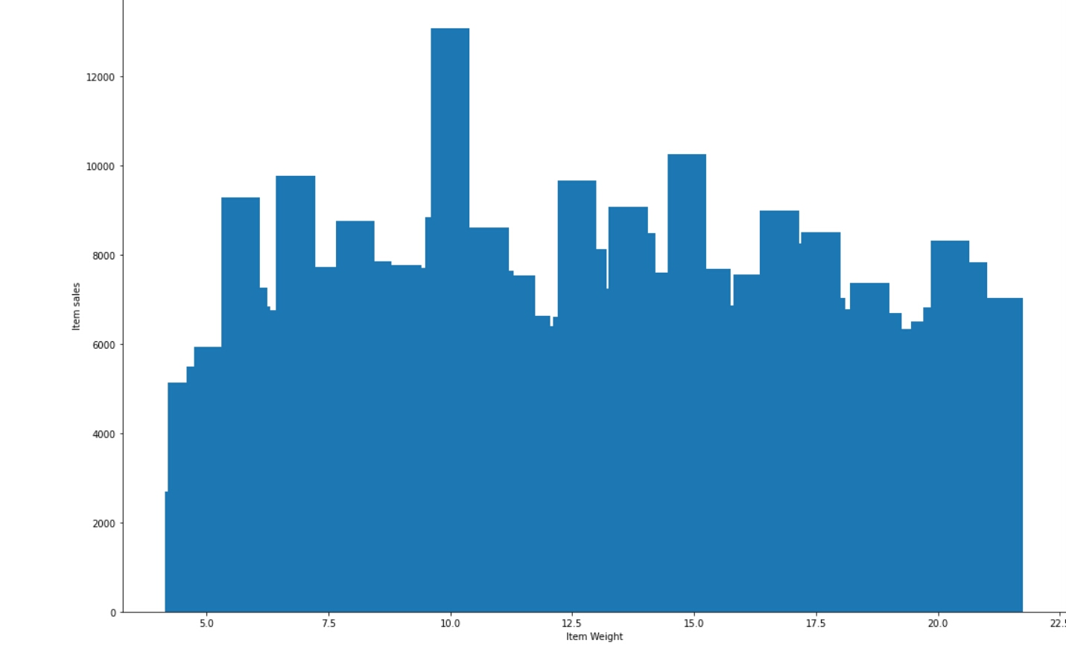
1. Item Weight: ➔The highest weighted Item is 21.5kg. ➔The lowest weighted Item is 2.5kg. ￼The highest weighted products sold is 10kg .

Slide 13
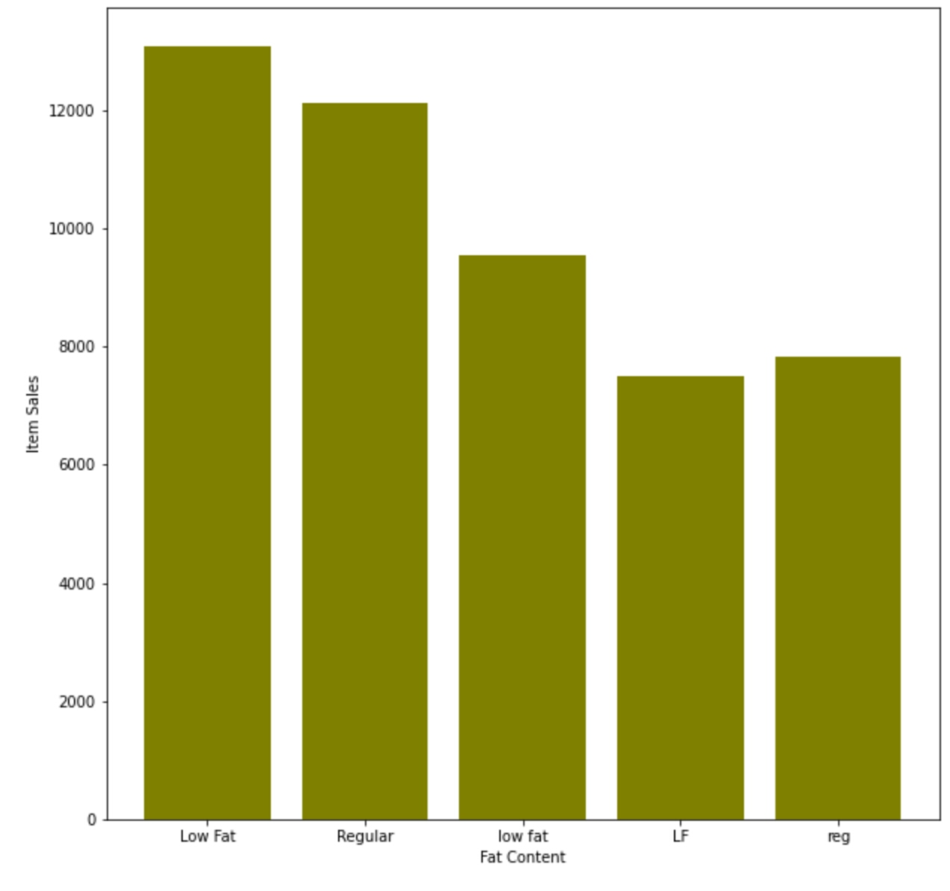
2.Item Fat Content: ➔There are 5 categories as shown in graph. ➔But There are only 2 types of fat content. ➔Low Fat or low fat or LF means the same . ➔ Regular or reg means the same.

Slide 14
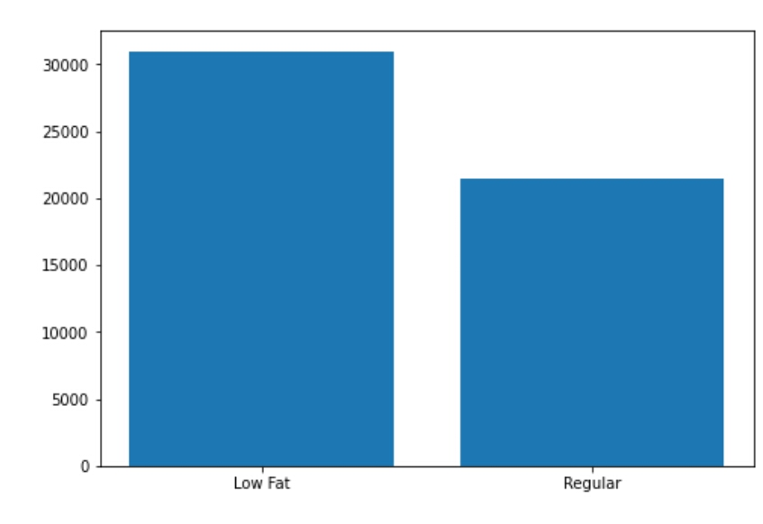
The updates graph : ➔ The total number of product sold out for low fat is 31,000. ➔The total number of product sold out for the regular is 22,500. ➔As we can see the value of Low Fat products have a huge difference ( 9,500)

Slide 15
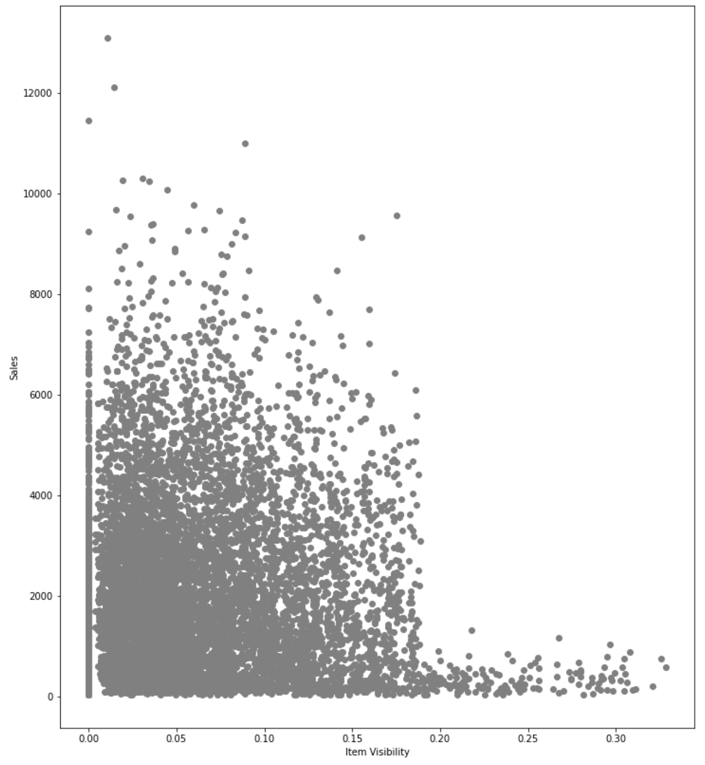
3. Item Visibility: ➔The most attractive part of a supermarket or store is displaying of products. ➔The Store have displayed 0-35% of product. ➔19-35% displayed products are lease sold . ➔ 2-18% displayed products are highly sold.

Slide 16
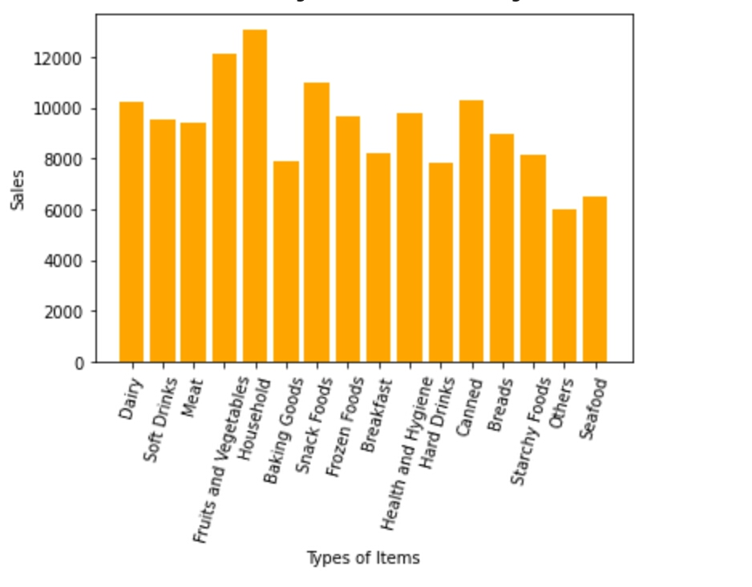
4. Item Type: ➔There are 16 categories . ➔Nearly , 13,000 products of Household are sold.￼￼ ➔Fruits and Vegetables have 12,000 products sold. ➔ Other have least number of product s sold (6,200).

Slide 17
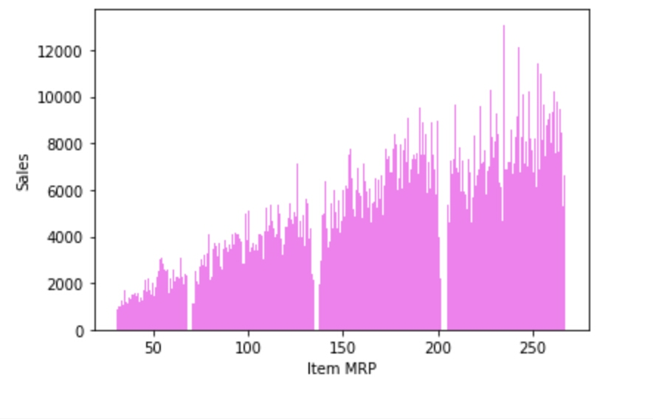
5. Item MRP: ➔ There are 4 Types of division between MRPs. ➔Lower MRP products are lease sold. ➔ Higher MRP products are highly sold.

Slide 18
Stores and it’s details :
Store | Year of establishment | Outlet Size | Outlet Location | Outlet Type
Store 1: | 1999 | Medium | Tier 1 | Supermarket Type-1
Store 2: | 2009 | Medium | Tier 3 | Supermarket Type-2
Store 3: | 1998 | High | Tier 3 | Grocery store
Store 4: | 1987 | High | Tier 3 | Supermarket Type-1
Store 5: | 2002 | Medium | Tier 2 | Supermarket Type-1
Store 6: | 2004 | Small | Tier 2 | Supermarket Type-2
Store 7: | 1997 | Small | Tier 1 | Supermarket Type-1
Store 8: | 2007 | Medium | Tier 2 | Supermarket Type-1
Store 9: | 1985 | Medium | Tier 3 | Supermarket Type-3
Store 10: | 1985 | Small | Tier 1 | Grocery store

Slide 19
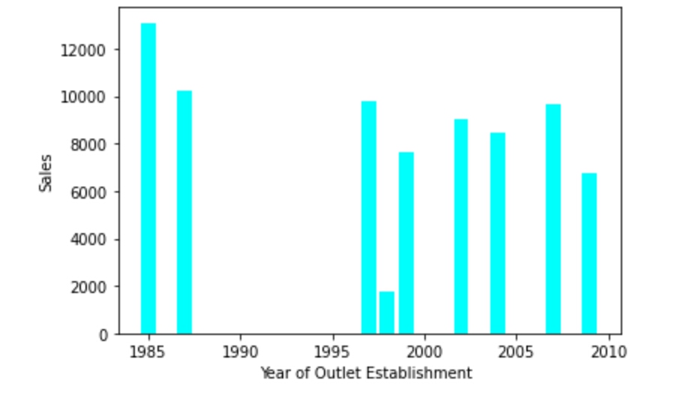
6. Outlet Establishment Year: ➔There were two stores opened in year 1985. ➔The Store Established in year 1987 has the highest number of individual products sold. ➔The Store Established in year 1998 have least number of product sold.

Slide 20
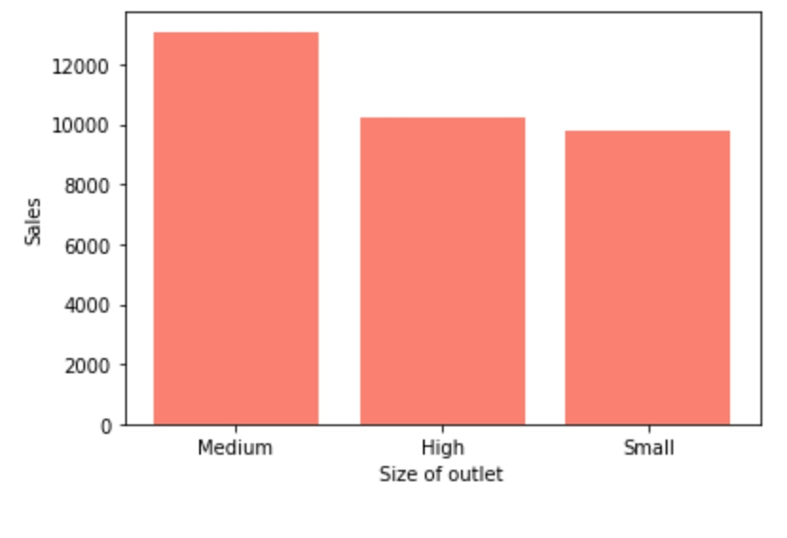
7. Outlet Size: ➔ There are only three categories. ➔ Medium size have more number of product sold. ➔ High and Small size products are almost same.

Slide 21
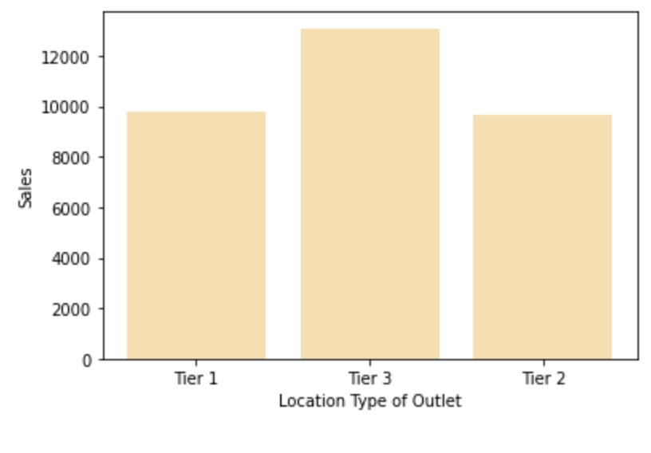
8. Outlet Location Type: ➔ There are only three categories. ➔ Tier 2 has highest number of products sold. ➔ Tier 1 and Tier 3 almost same number of product sold .

Slide 22
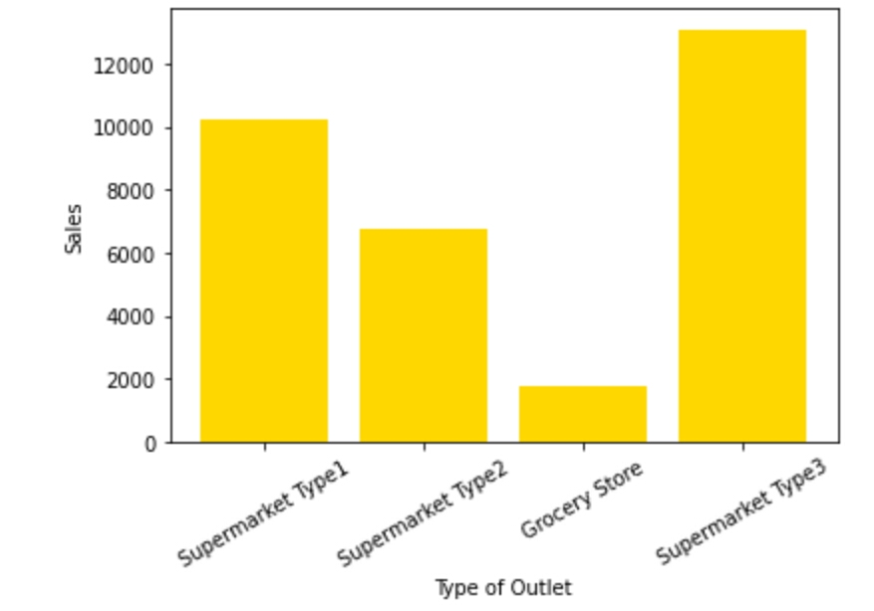
9. Outlet Type: ➔ There 4 Types of categories. ➔Supermarket( 1,2,3 ) and grocery store. ➔ Supermarket type 3 have highest number of products sold. ➔ Grocery store have least number of products sold.

Slide 23
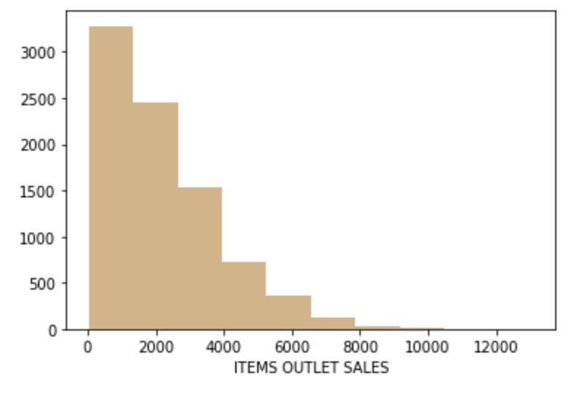
10. Item Outlet Sales: This graph is plotted between “ Item Outlet Sales” and “Frequency”. We can see that the frequency is rapidly decreases. Sales drops by 16.7% then 40% ...... The last frequency is at 10,000 .

Slide 24
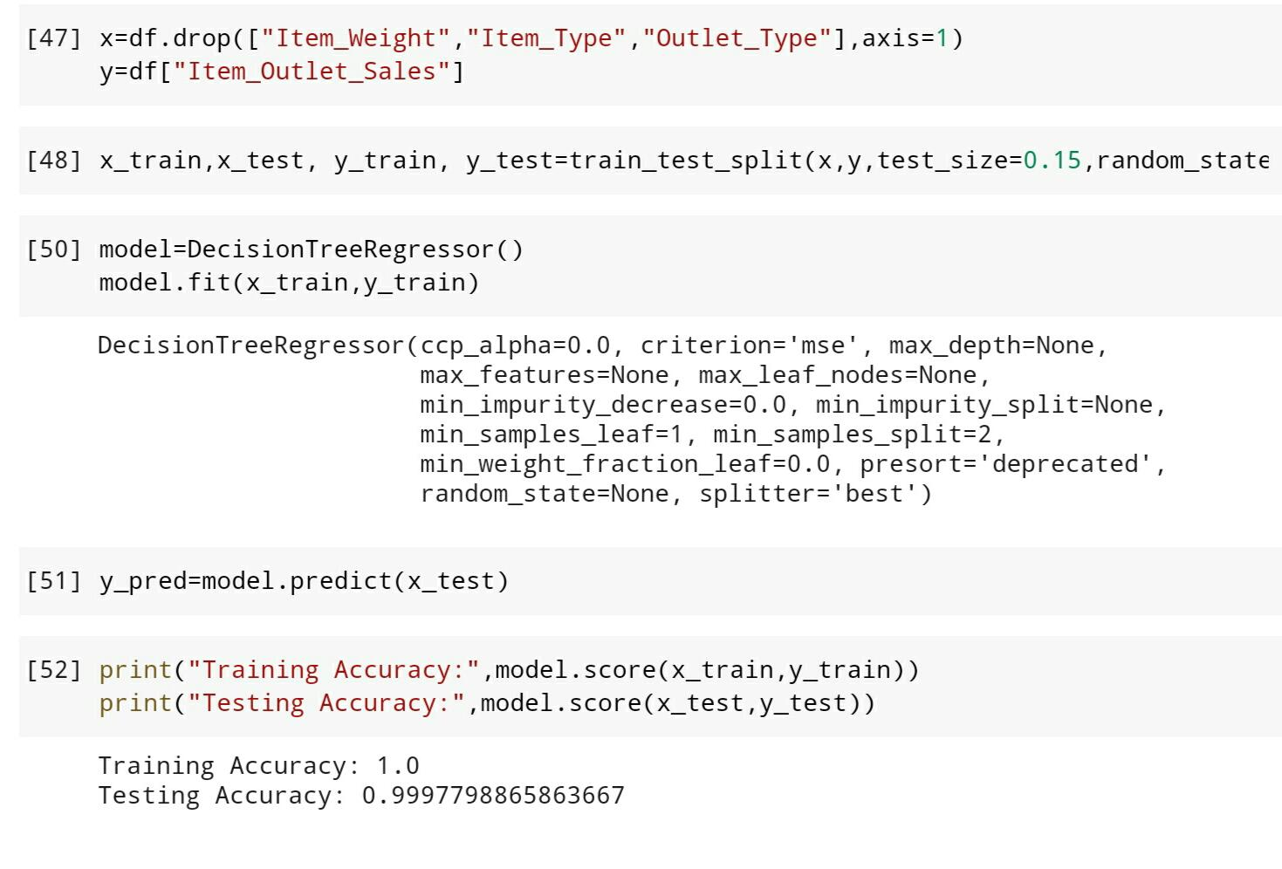
Results of Model Building:
1.Item weight (without dropping “Item Outlet Sales”)

Slide 25
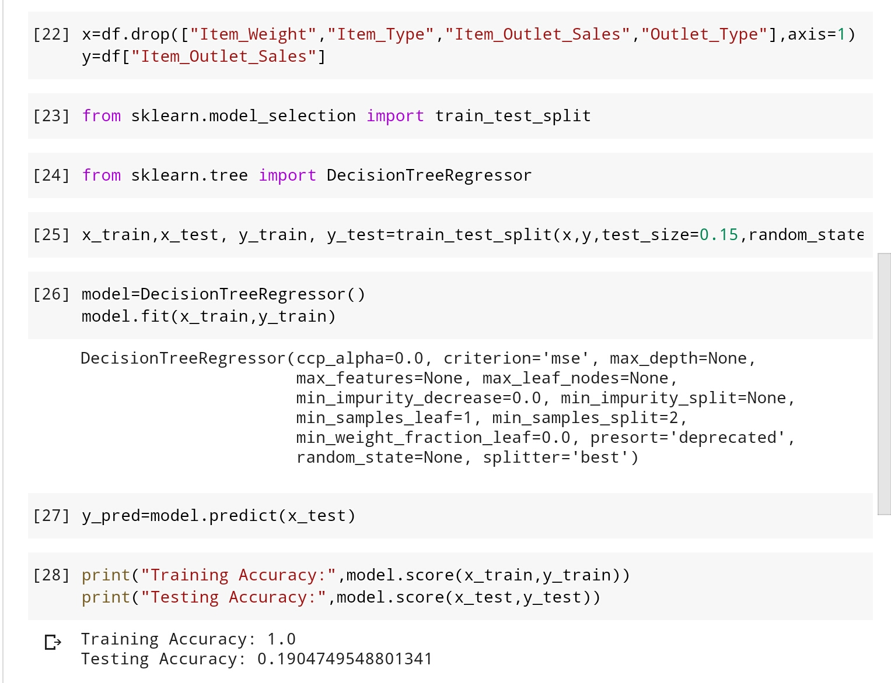
2. Item weight ( with dropping “Item Outlet Sales”):

Slide 26
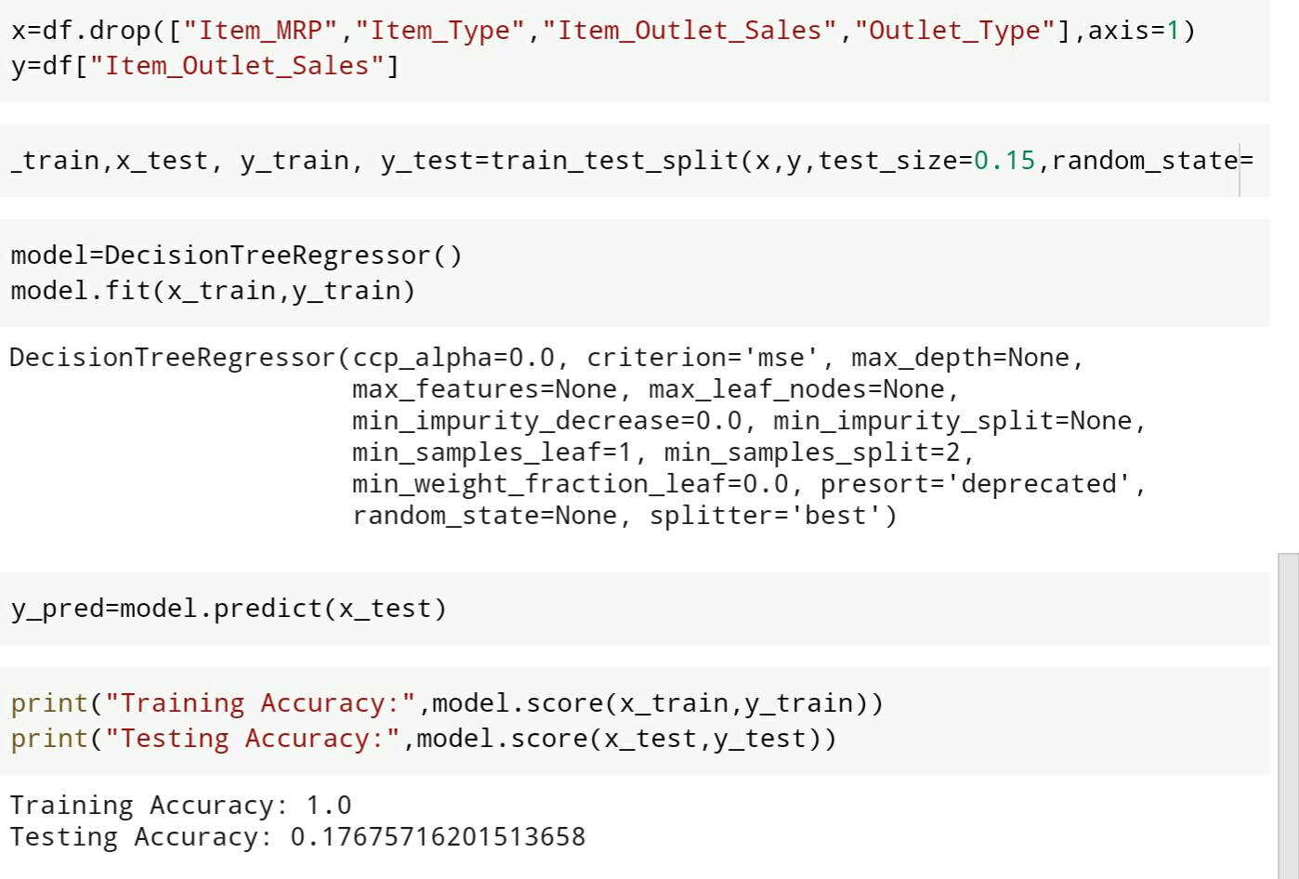
3. Item MRP ( with dropping “Item Outlet Sales”):

Slide 27
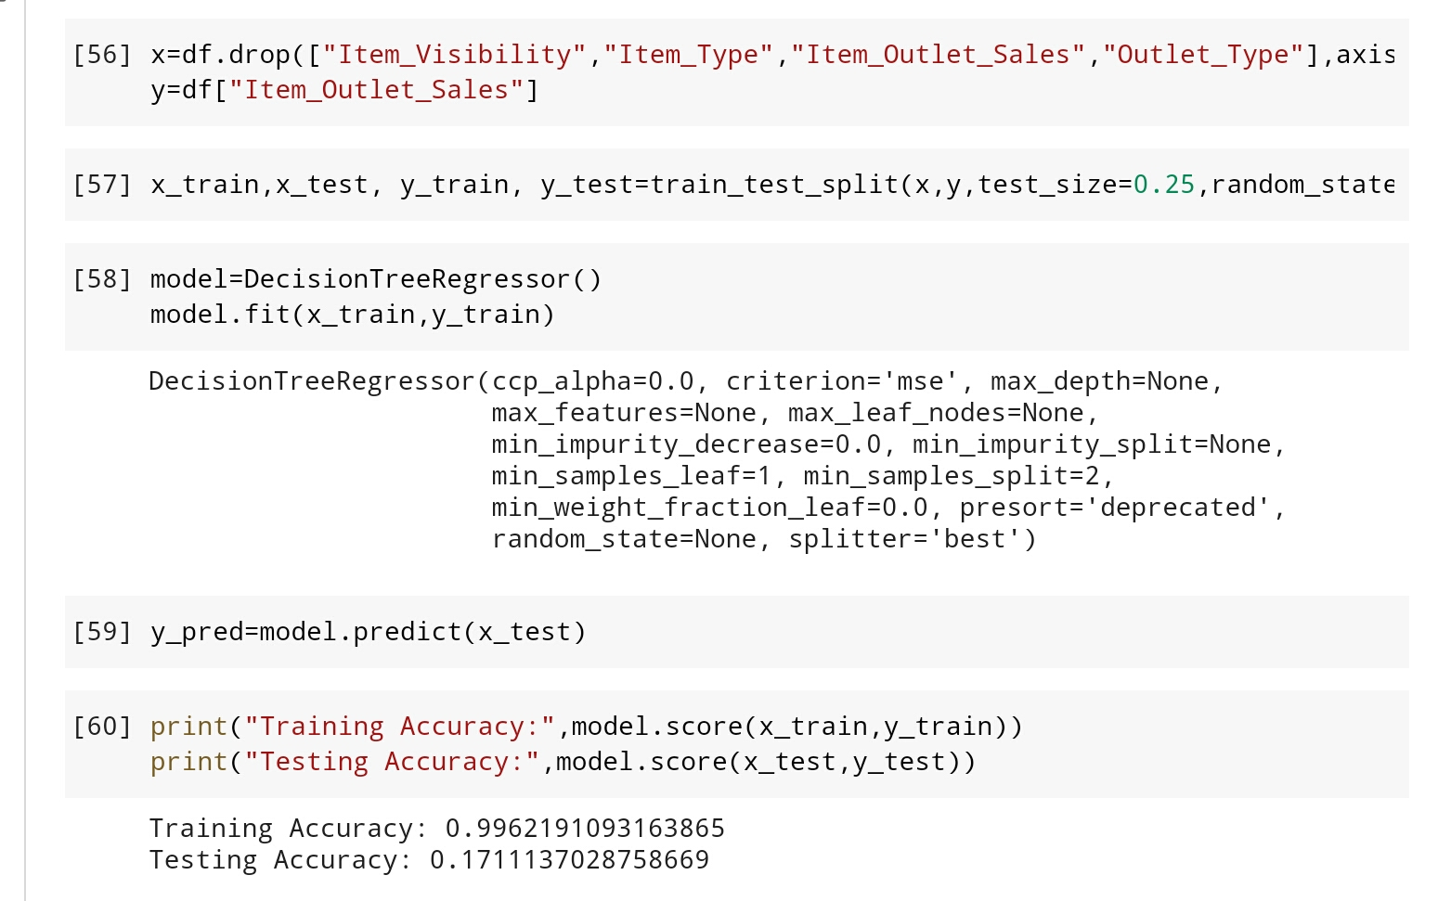
4. Item Visibility ( with dropping “Item Outlet Sales”):

Slide 28
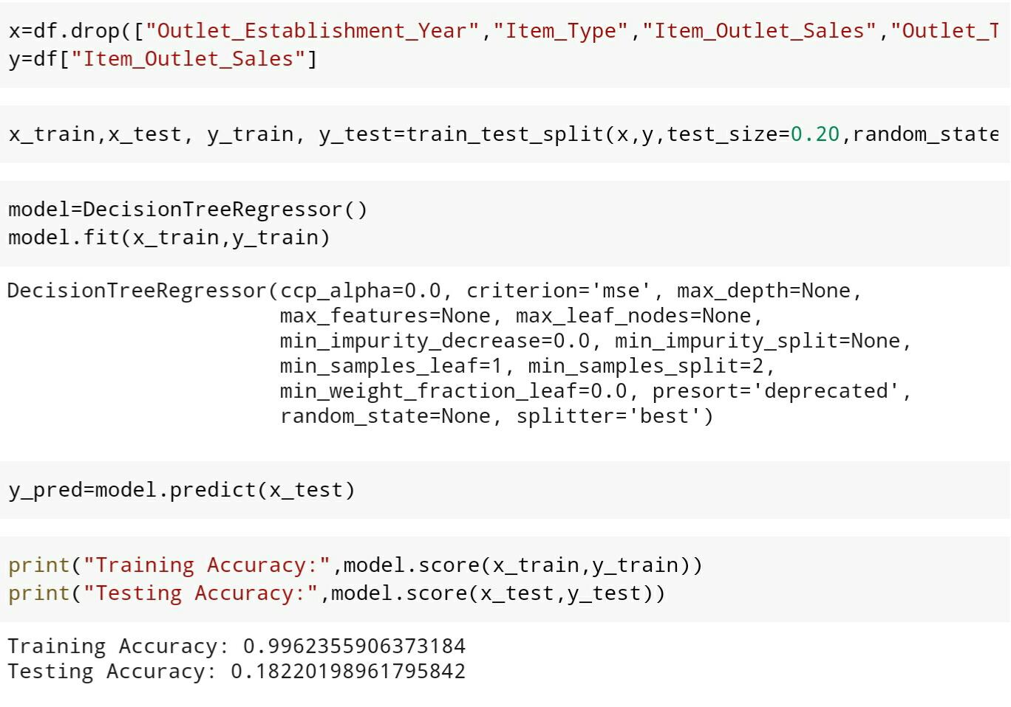
5. Outlet Establishment Year( with dropping “Item Outlet Sales”):

Slide 29
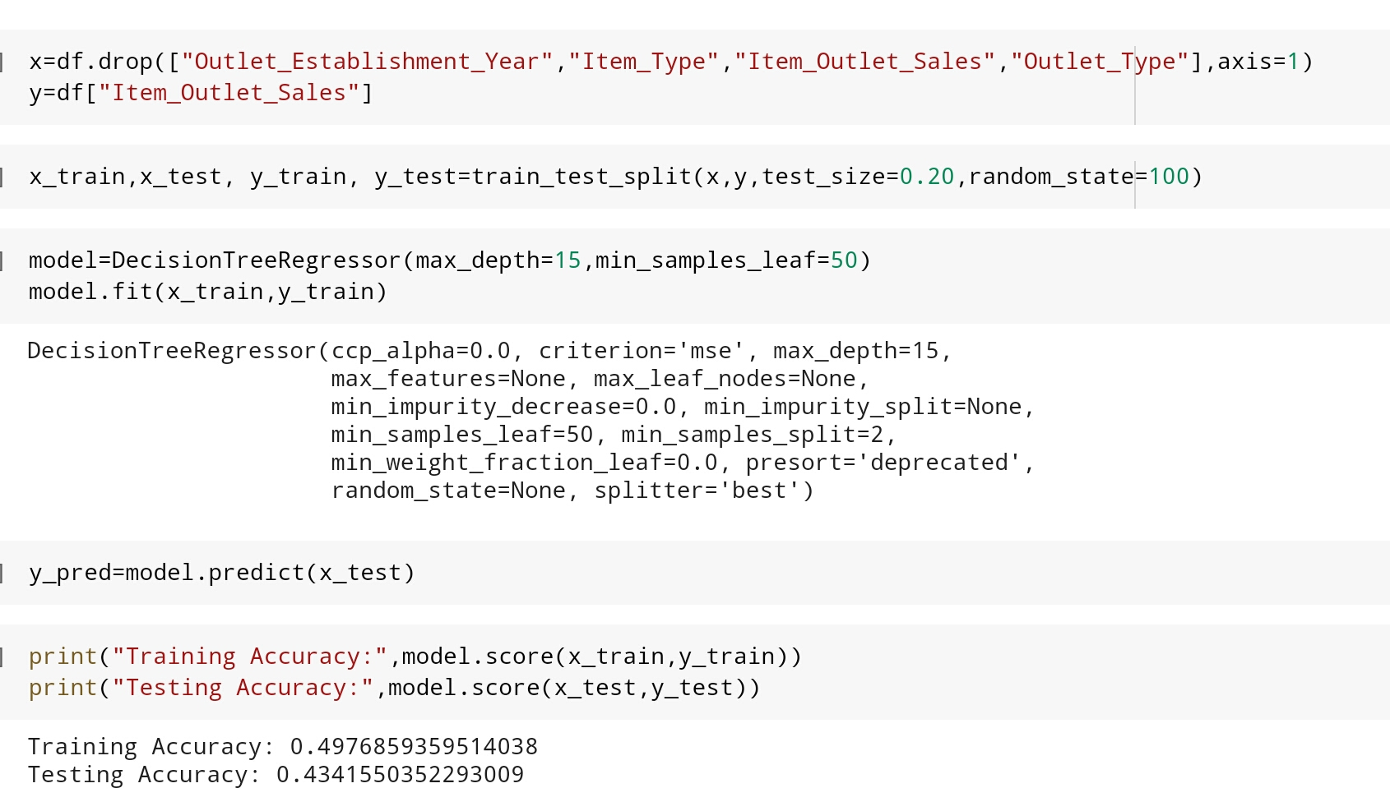
Model Building type 2:
5. Outlet Establishment Year( with dropping “Item Outlet Sales”):

Slide 30
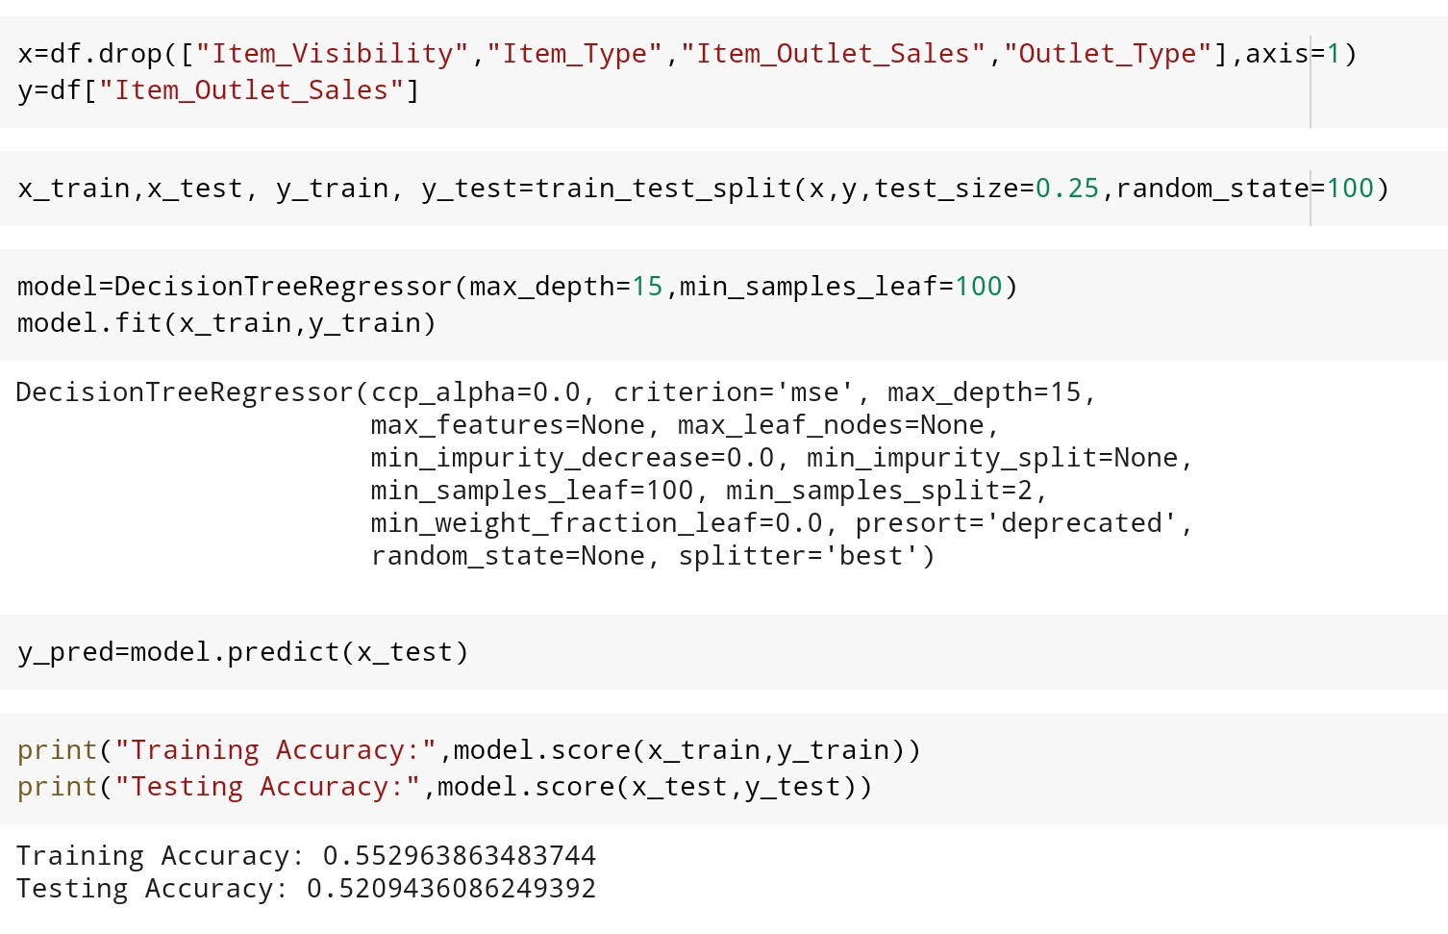
2. Item Visibility (with dropping “Item Outlet Sales”:

Slide 31
Conclusion:
After the brief visualization of the following data “BigMart” . The Factors that play an important role in increase of sales are :
Fat Content- Fat Content brings a huge impact in Sales. It is the most preferred choice of customers.
Item visibility-Item Visibility with 2-19% attracts more number of customer’s.
Household Item, Fruit, Vegetables and Snacks have more number of products sold . Hence it plays an important role in increasing of sales.
Item MRP- Higher MRP products are highly sold in Sales .

Slide 32
5. Outlet Establishment Year- Old is Gold , hence the old store attracts more customers in sales.
6. Medium size with Tier 3 location is like a good mine .
7. Supermarket Type-3 increase the sales by 20% when compared to others.
These are the number of various features which can bring a huge impact on sales .

Slide 33
Thank You

